Slide 1
Optimizing Diffusion Models for MNIST
Efran Himel, Anvita Patel, Alex Peterson
Notes:
Efran
Anvi, Alex, and Efran presenting MNIST Diffusion Models for CS 682

Slide 2
Models
What is Diffusion: The process of generating new images based off of training data by adding and removing noise.
Noise-Conditioned Score Network (NCSN)
Score-based generative models (SGM) aim to directly learn the gradient of the data distribution and they are trained to assign high scores to observed data and low scores to generated samples.
Denoising Diffusion Probabilistic Models (DDPM)
Perform diffusion in two phases, a forward noise phase and a reverse diffusing phase. In the first phase, DDPM gradually applies gaussian noise to an image over multiple steps until the image is complete noise. During the reverse diffusing phase, a neural network is trained on gradually denoising the noised image until a new clear image is produced.
Notes:
Efran
What is diffusion: generative models that learn from adding & removing noise to training img to make new image
1- learn gradient distribution of img to assign high score obs low score generated to produce new img
2- gradually add gaussian noise to img over steps then denoise the image to produce new images

Slide 3
Evaluation
Fréchet Inception Distance (FID) Score
Used to evaluate the quality and diversity of images generated and measures the similarity between the distribution of real and generated images.
Model Metrics
Model Size (bytes)
Training Time (ms/epoch)
Inference Time (ms)
Notes:
Anvi

Slide 4
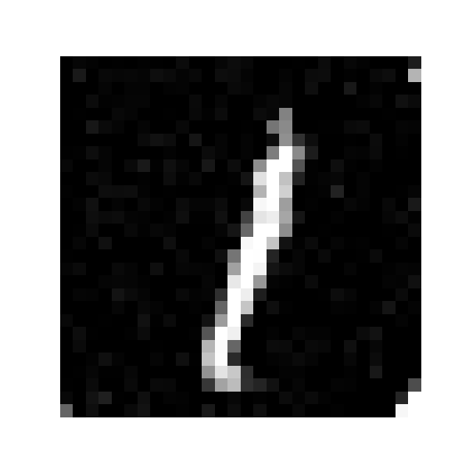
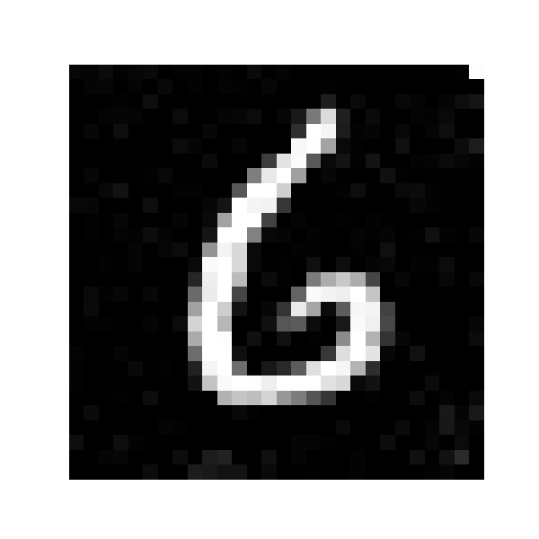


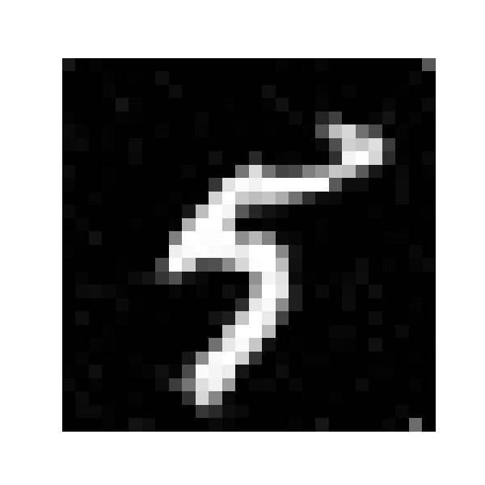

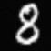

Baseline
NCSN Diffused Images
DDPM Diffused Images
FID Score: 182.1
FID Score: 150.4
Notes:
Anvita

Slide 5
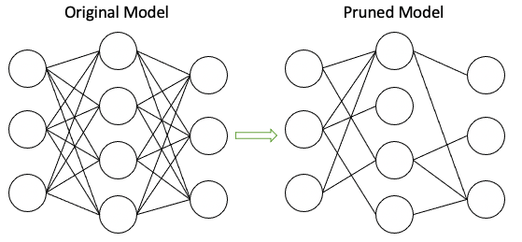
Pruning
Dropping weights, neurons or layers of a neural network.
Notes:
Alex

Slide 6
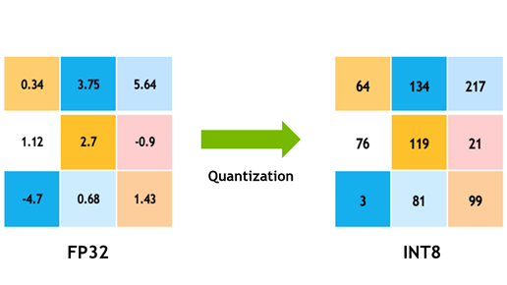
Quantization
Decreasing the precision of weights and biases.
Notes:
Alex

Slide 7
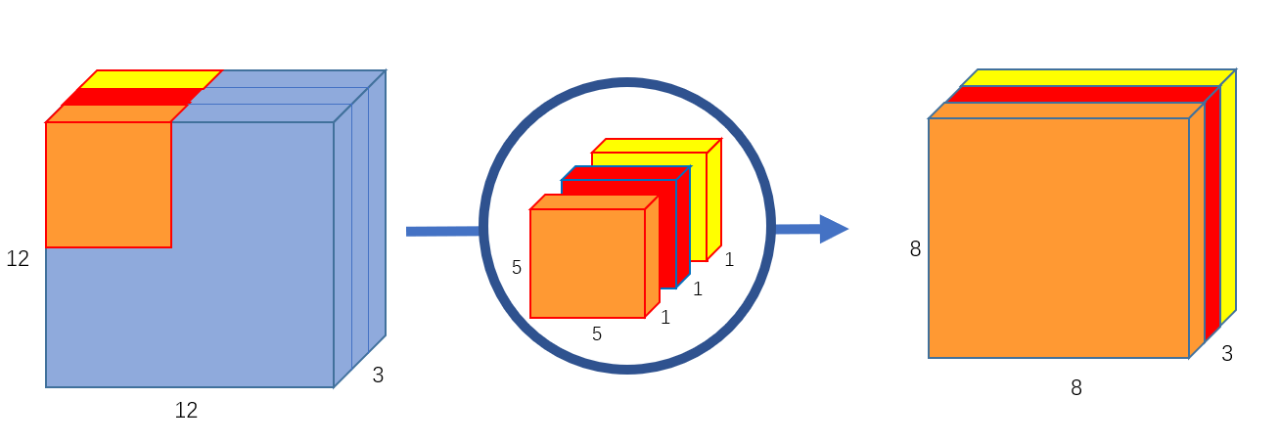
Depthwise Convolution
Splits the filters and input into groups and applies one filter per group in the layer, thus reducing the number of parameters in the layer.
Notes:
Alex

Slide 8
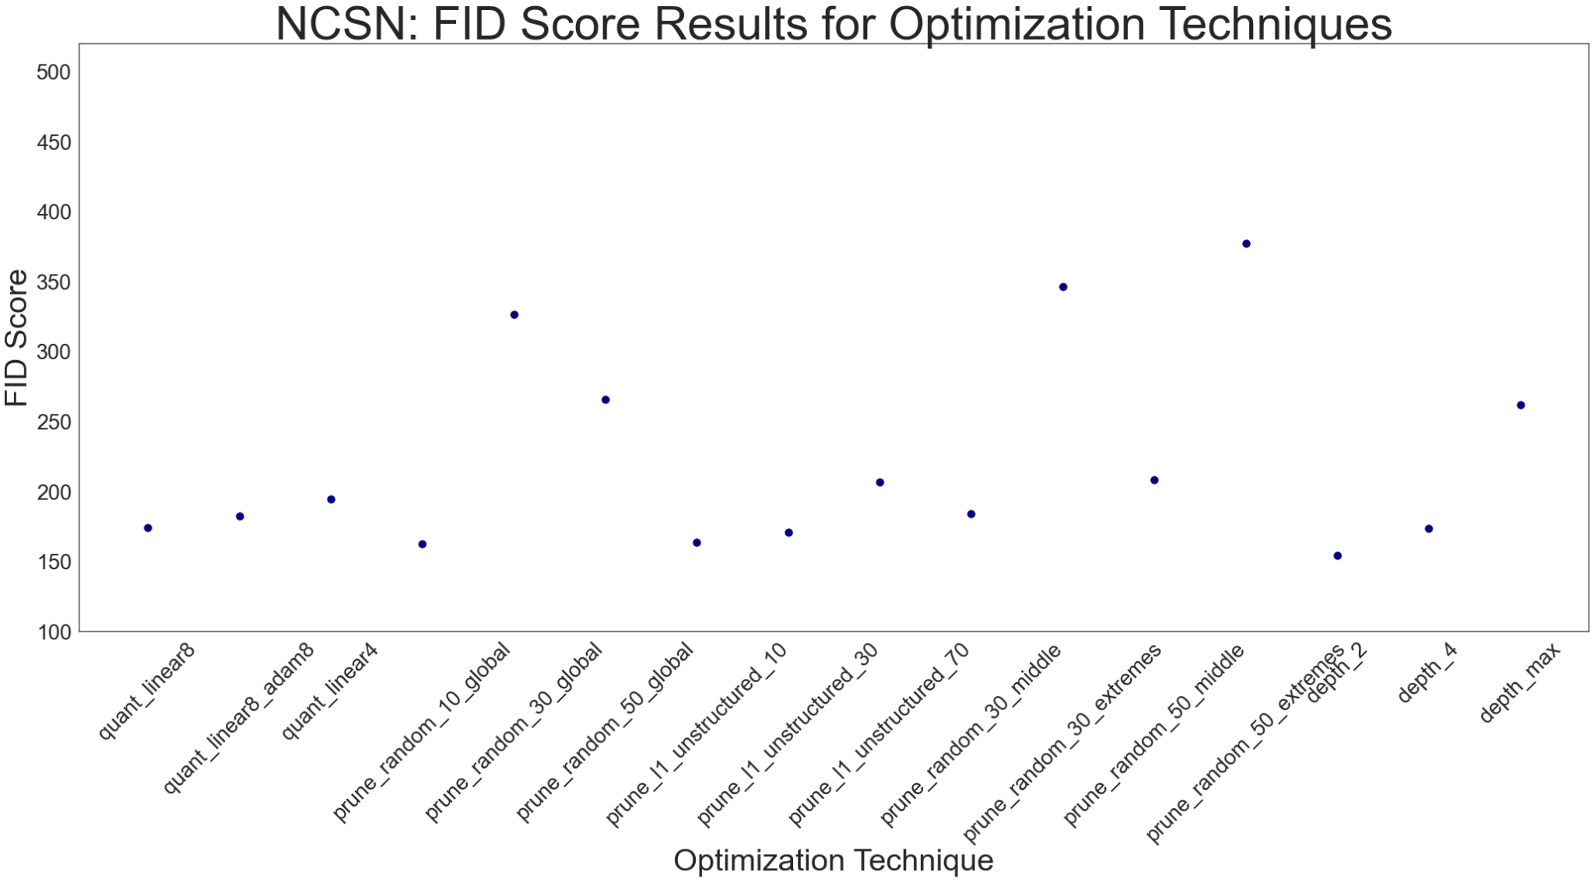
Results: NCSN
Notes:
Anvita

Slide 9
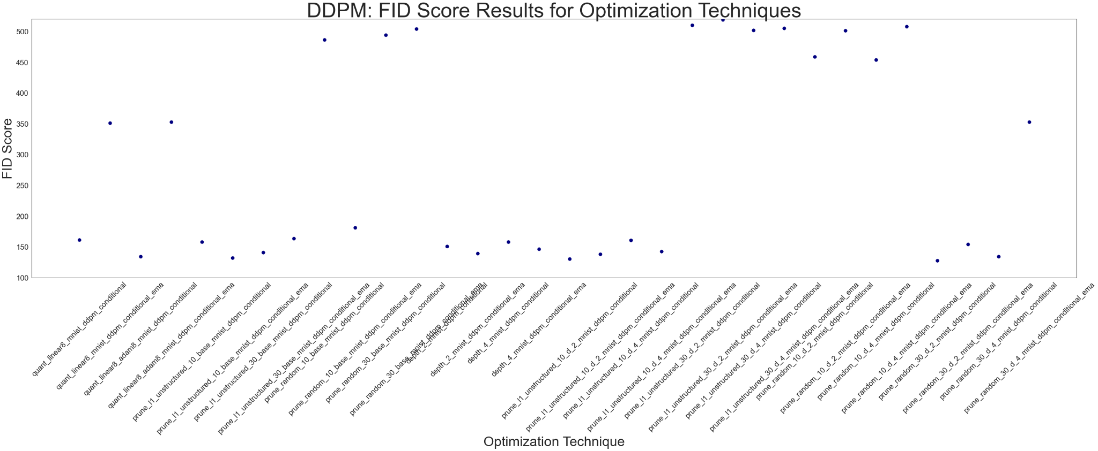
Results: DDPM
Notes:
Anvita

Slide 10
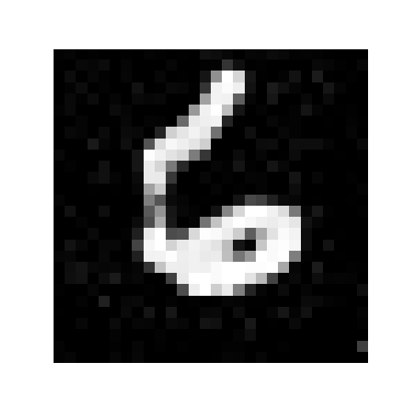
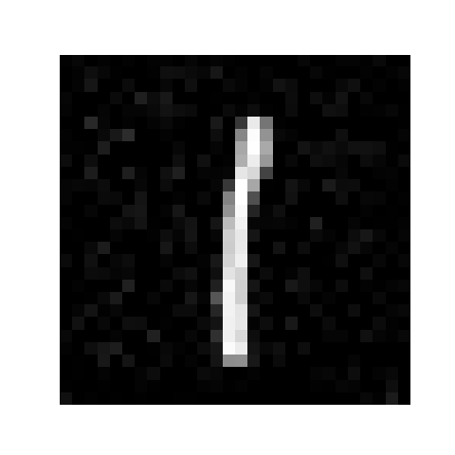


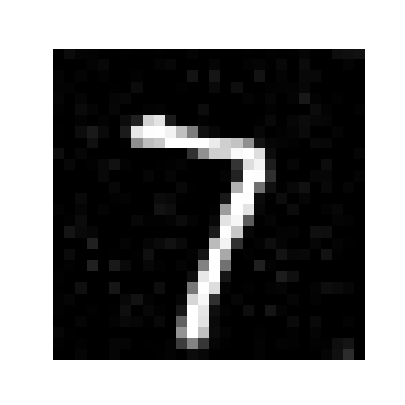

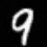

Best Optimized Models
NCSN Depthwise Group 2
DDPM + CFG with Depthwise Group 2 and Prune L1 Unstructured at 10%
FID Score: 154.3
FID Score: 130.4
Notes:
Efran
best models with high fid score and lowest model size

Slide 11

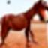
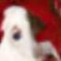

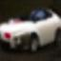
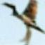
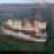
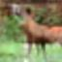
Applied to CIFAR-10
Best model architecture, DDPM + CFG with Depthwise Group 2 and Prune L1 Unstructured at 10%, and applied it to CIFAR-10
Notes:
Efran
best ddpm > best ncsm → apply model arch to cifar 10 to see the results

Slide 12
Thank you

